Slide 1

List of Medical colleges in India 2026
Presented by :
B.Srujan Goud
Batch No : 504

Slide 2
About ME
Background:
I completed my Bachelor of Technology in CSE [AI-ML] from Nalla Malla Reddy Engineering College
Why you want to learn Data Science:
I want to learn data science to improve my skills and get high payeable job.
Any work experience:
So, far I have no experience
LinkedIn : https://www.linkedin.com/in/baddam-srujan-goud-247798392?utm_source=share_via&utm_content=profile&utm_medium=member_android
GitHub : https://github.com/Srujangoud163

Slide 3
Agenda
Business Problem
Problem Statement
Objective
Use Case
Data Collection
Web Scraping Process
After Scraping/Before Cleaning Data
Summary of Data
Data Cleaning Steps
Data Visualization(Univariate,BivariateAnalysis)
Conclusion
Q&A Slide

Slide 4
Business Problem
Indian students aspiring to pursue medical education face significant challenges in finding the right college
Currently, students and parents must manually search through dozens of college listing pages, filter by state/city, and compile information across different sources to make informed decisions.

Slide 5
Problem Statement
Students and parents seeking medical college admissions in India lack a centralized, structured database that allows them to:
•Compare medical colleges across multiple parameters (location, ownership, affiliation, establishment year)
•Filter colleges based on their preferences (government vs. private, specific cities, affiliated universities)
•Make informed decisions without visiting multiple websites manually

Slide 6
Objective
The objective of this code is to web scrape detailed information about medical colleges in India from the website ‘indiaccess.com'. It iterates through 23 pages of the medical colleges listing (from page 1 to page 23) and extracts six key pieces of information for each college: the college name, city, full address, year established, ownership type, and affiliated university.

Slide 7
Use Case
•Students will use the output to compare medical colleges based on city, ownership type, establishment year, and affiliation before choosing where to apply for MBBS.
•Researchers will use the dataset to study trends in India’s medical education system, such as the distribution of government vs. private colleges and regional coverage across cities.
•Educational platforms will use the cleaned data to build searchable online directories where users can filter and browse medical colleges by various criteria.

Slide 8
Web Scraping Process
Import Required Libraries :
Requests library to fetch web pages
BeautifulSoup for parsing HTML content
Regular expressions (regex) for extracting specific patterns like years and ownership types
Pandas for organizing data into a structured table format
numpy , matplotlib : For data analysis and visualization .

Slide 9
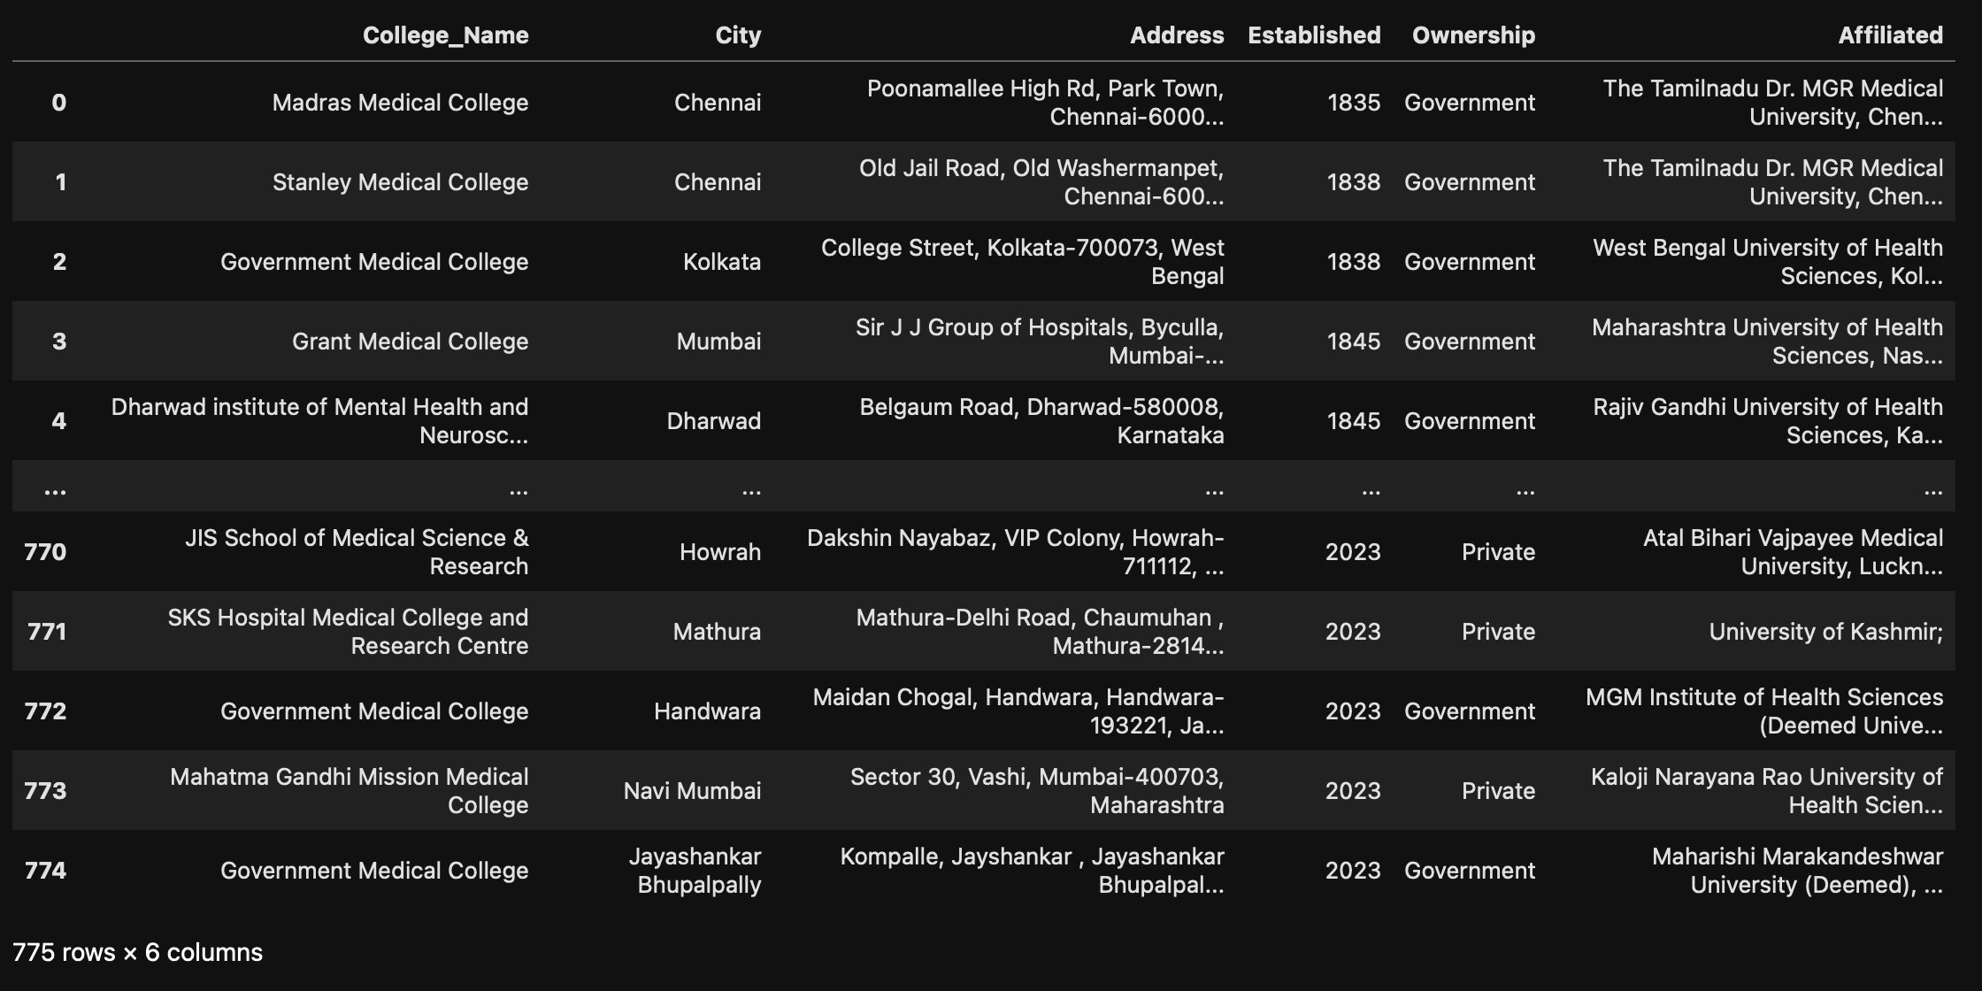
After Scraping/Before Data Cleaning

Slide 10

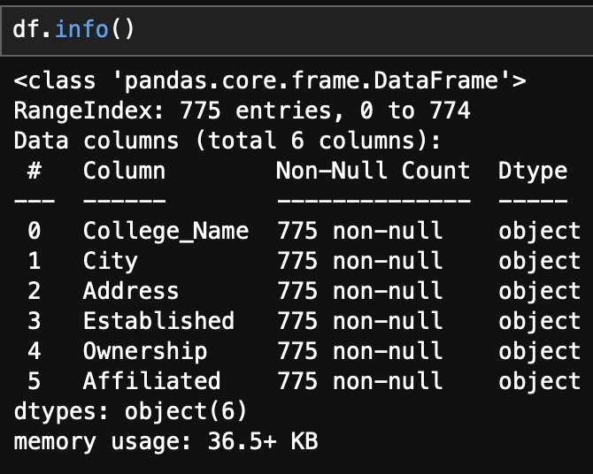
Summary Of The Data

Slide 11
Data Cleaning Steps
After scraping, the data usually exists as raw Python lists and may contain extra spaces, missing values, repeated text, or uneven lengths. This is the intermediate stage before converting everything into a proper DataFrame for analysis.

Slide 12
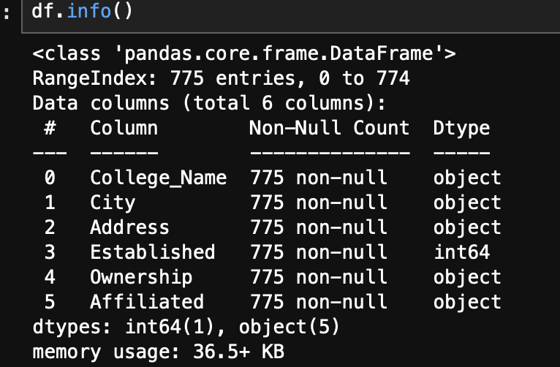
After Data Cleaning

Slide 13

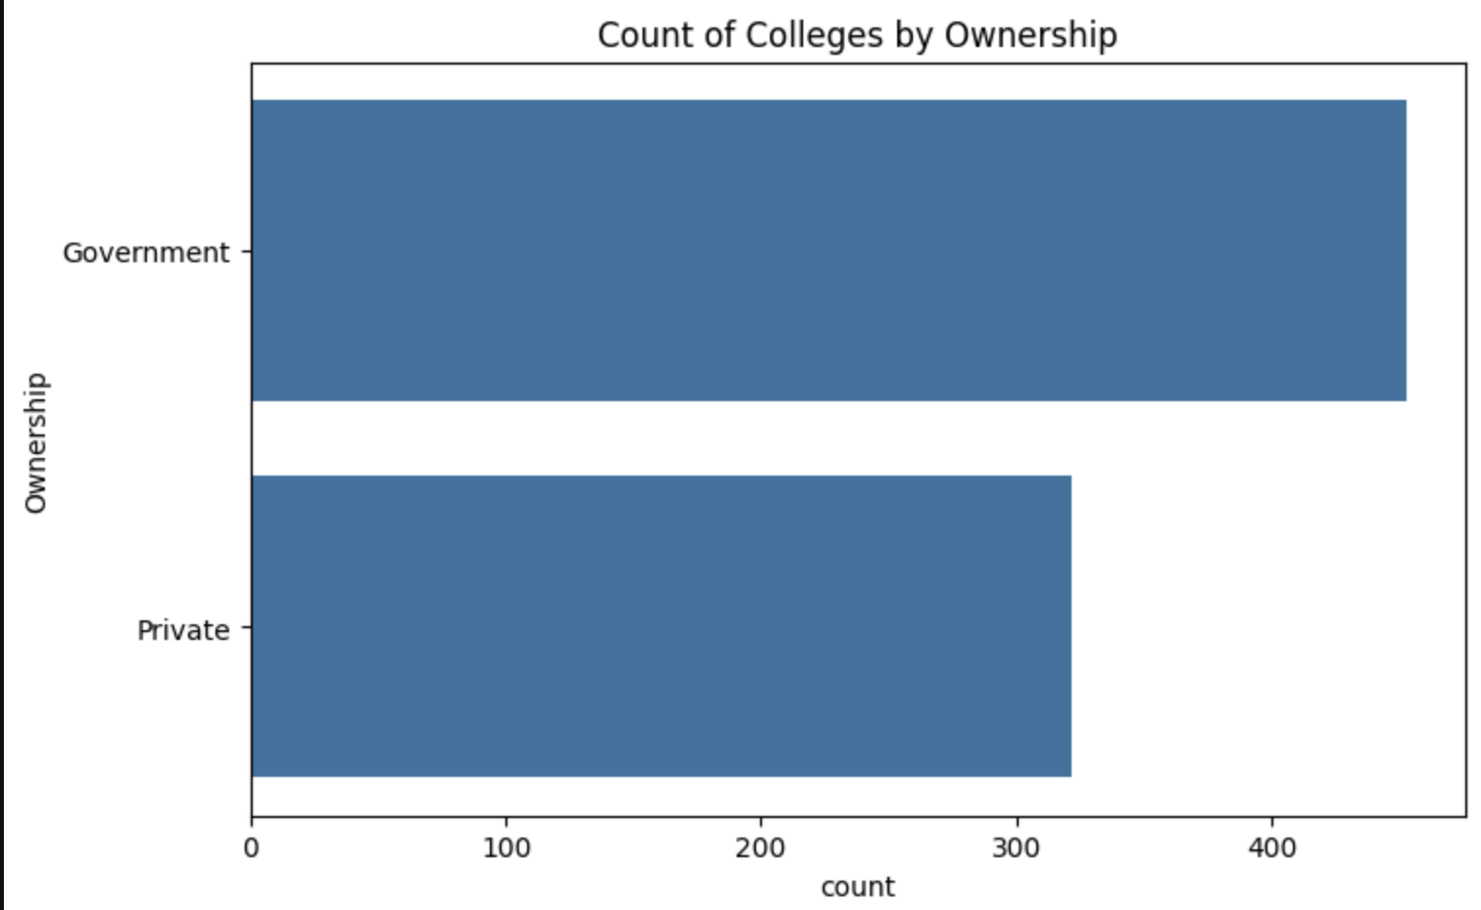
Data Visualization
Univariate Analysis
This horizontal bar chart represents a Univariate Analysis of college ownership, showing the distribution of "Government" versus "Private" institutions in a specific dataset.
Approximate Counts:
Government: There are approximately 450 colleges.
Private: There are approximately 320 colleges.
Comparison: There are roughly 1.4 times as many government colleges as there are private colleges in this data.

Slide 14
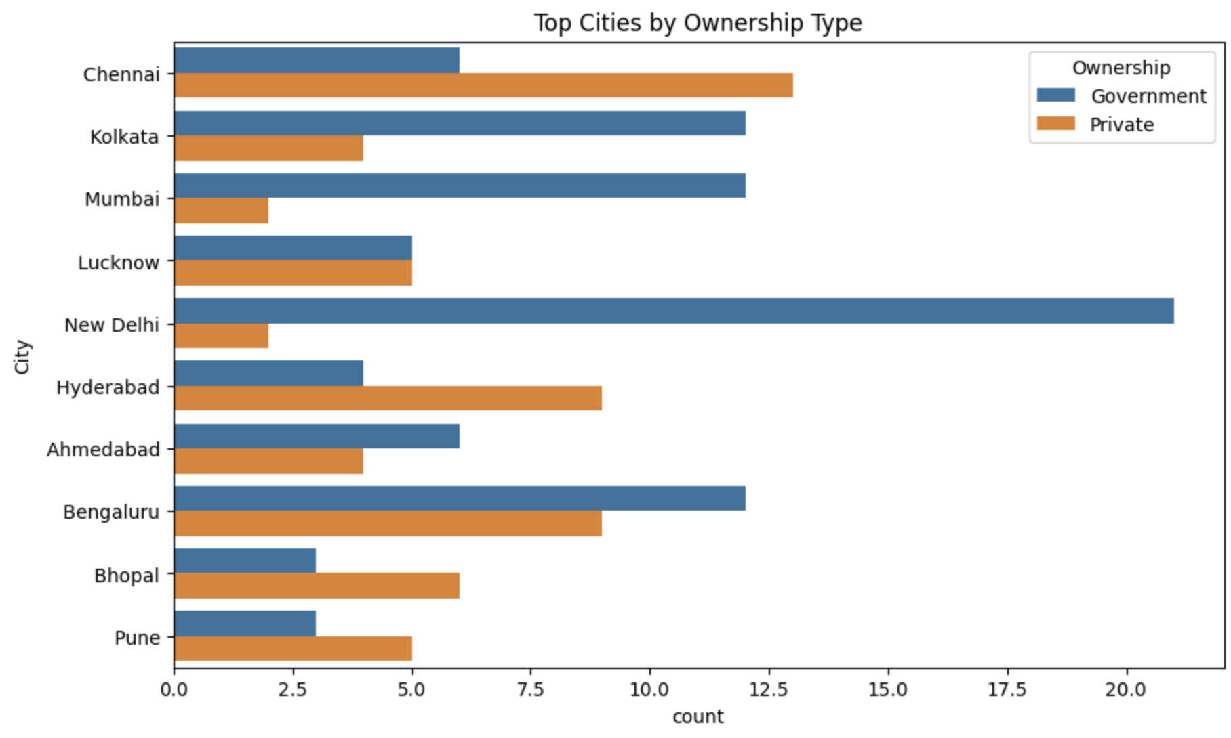
Comparison of Government vs. Private Colleges in Major Indian Cities
This bar chart visualizes the number of colleges in major Indian cities, segmented by their ownership type (Government or Private).
Top Cities by Count: New Delhi has the highest total number of colleges shown in the chart, primarily driven by a very large number of Government colleges.
Private vs. Government: While New Delhi is dominated by government colleges, cities like Chennai and Hyderabad show a higher prevalence of Private colleges compared to their government colleges.

Slide 15

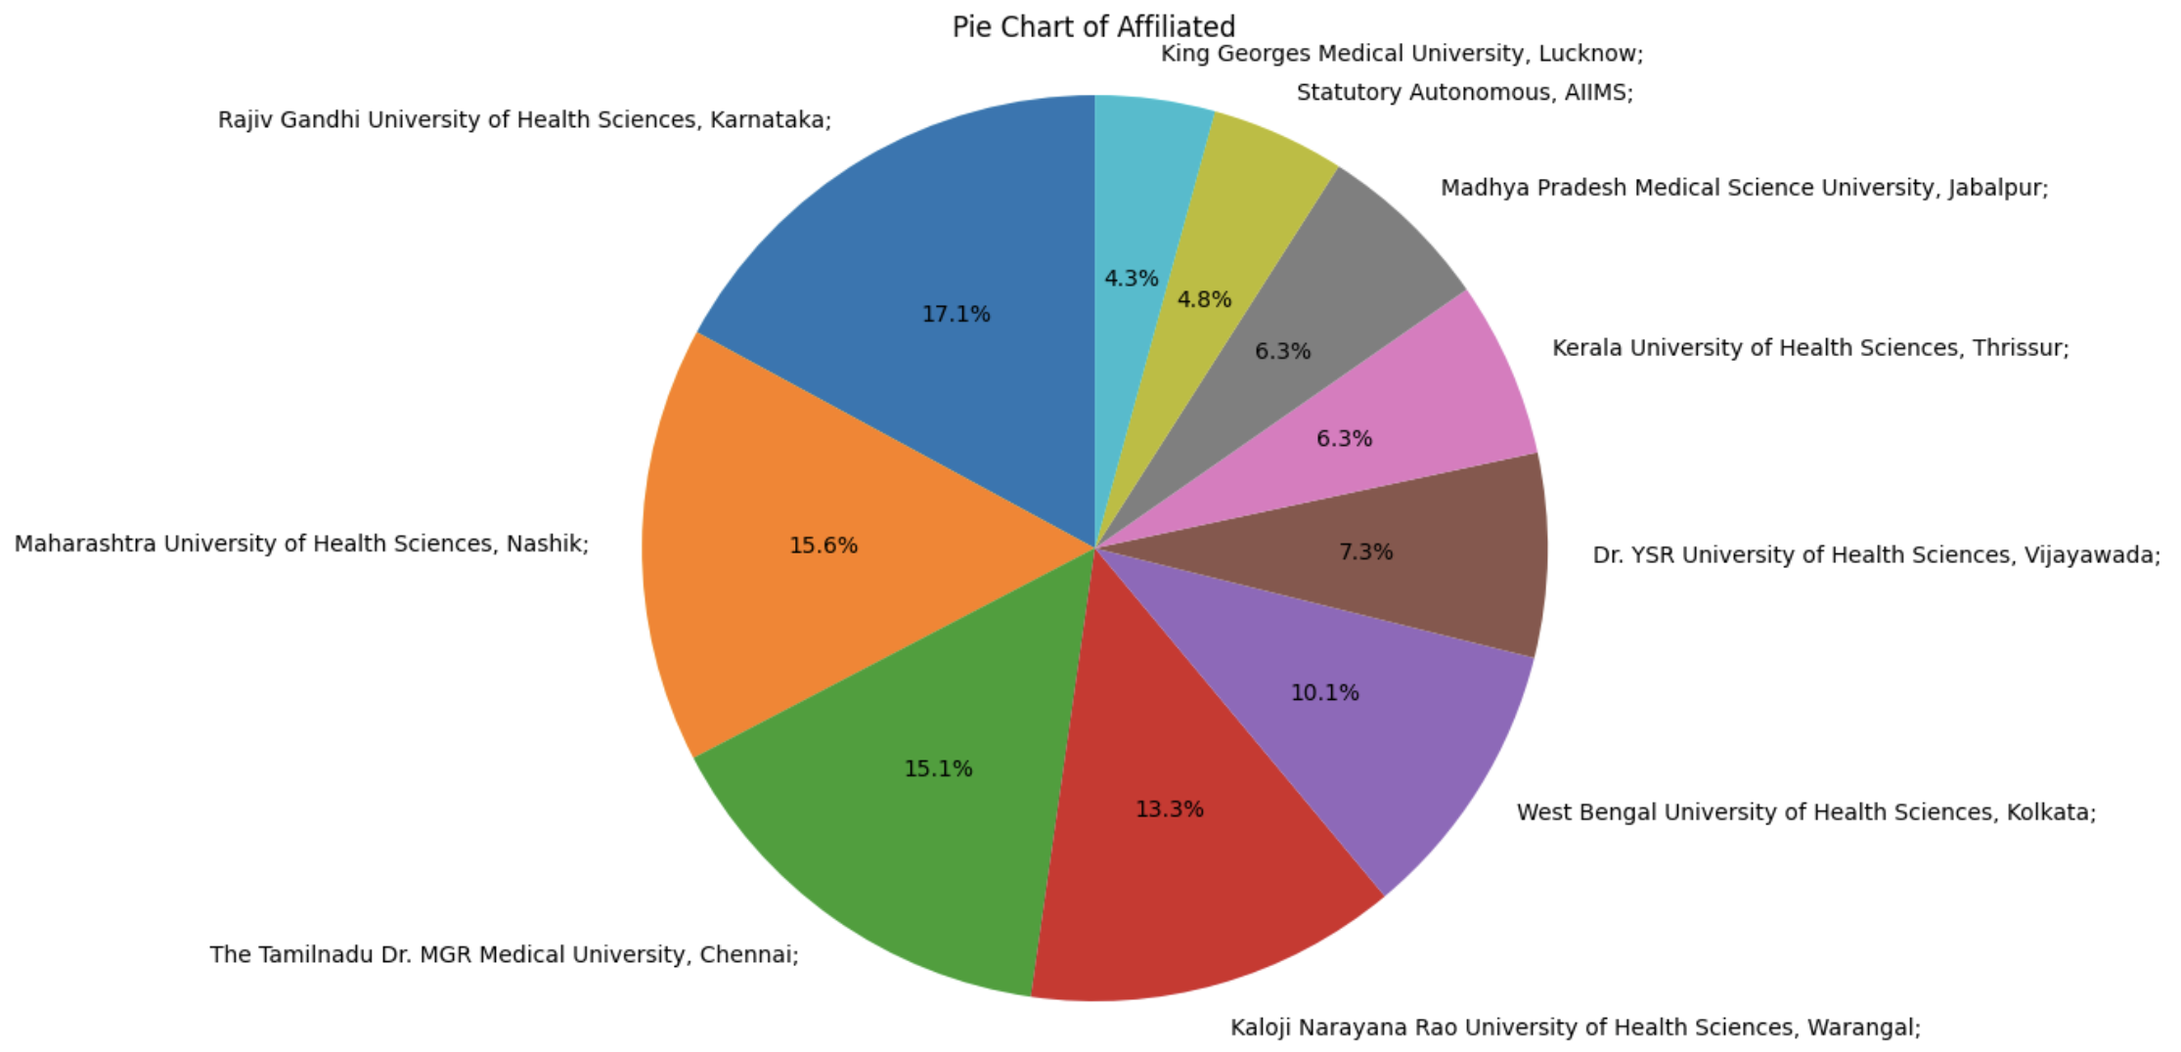
Distribution of affiliated colleges:
The pie chart visualizing the distribution of affiliated colleges.
Chart Purpose: The pie chart represents the percentage share of various institutions, with larger slices indicating a greater proportional contribution.
Data Representation: Individual slices are colored to distinguish between institutions, and numeric percentages are displayed within or alongside each slice.

Slide 16
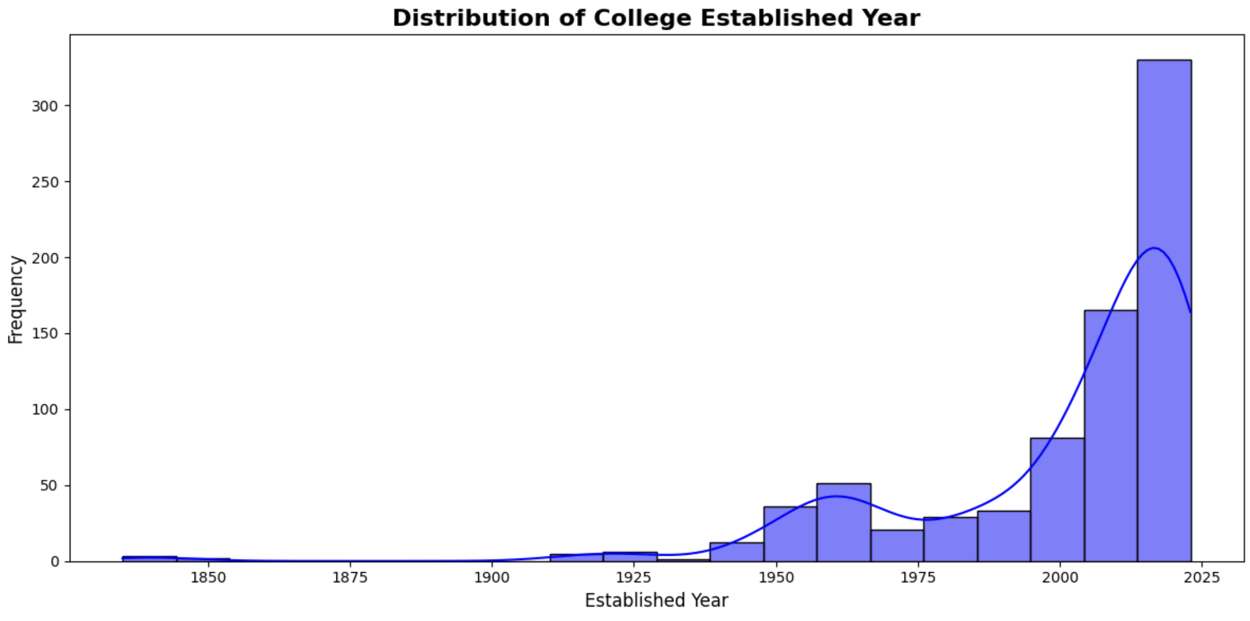
The distribution of college establishment years:
The distribution of college establishment years:
Significant Growth Trend: The data shows a dramatic increase in the number of colleges established in the modern era, particularly accelerating after the mid-20th century.
Recent Peak: The highest frequency of college establishments occurs in the most recent bin (approximately 2000–2025), indicating a rapid expansion of higher education institutions in recent decades.
Historical Context: While there was some activity around 1830–1900, the data suggests a relatively slow pace of establishment until after 1950.

Slide 17
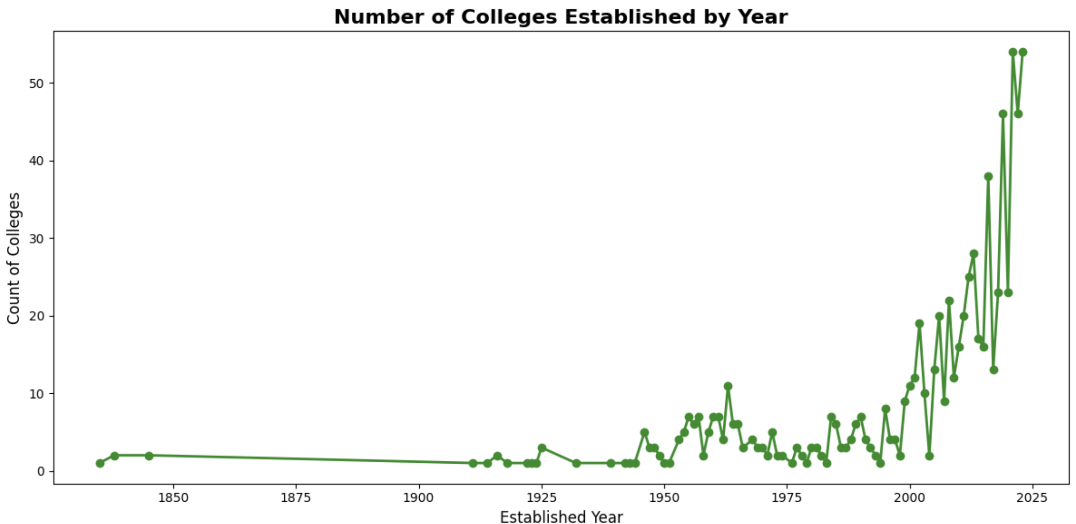

Slide 18

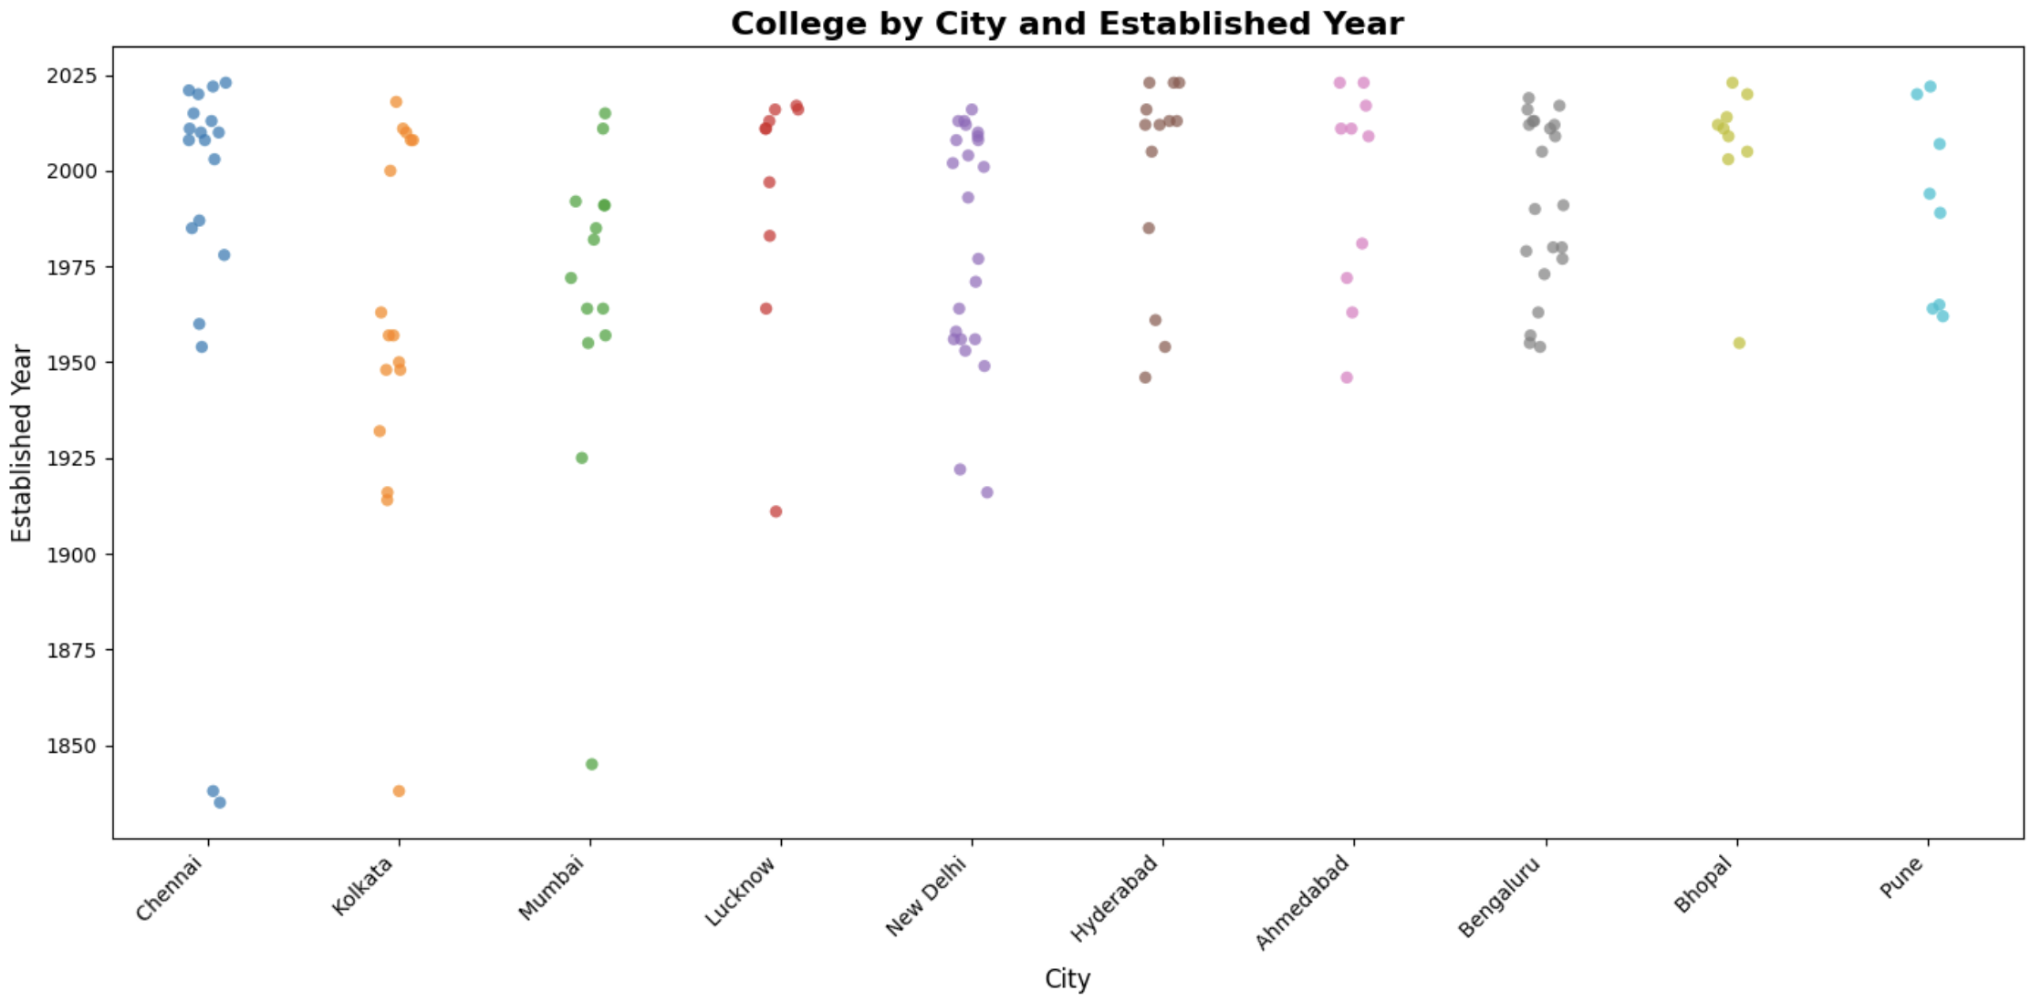
City-wise Growth of Colleges (1850–Present):
Bi-Variate Analysis
This scatter plot displays the distribution of colleges across various Indian cities based on their year of establishment.
The vertical axis lists several cities, including Chennai, Kolkata, Mumbai, Lucknow, New Delhi, Hyderabad, Ahmedabad, Bengaluru, Bhopal, and Pune.
The horizontal axis represents the Established Year, ranging from approximately 1850 to 2025.
The plot uses a technique called jittering to slightly spread out overlapping points, making it easier to visualize the density of colleges established in similar years for each city.
Data points indicate that the majority of colleges shown were established in the modern era, particularly between 1950 and 2025, with earlier institutions established as far back as the mid-19th century.

Slide 19
Recommendation
Based on City:
•Choose a city where you’re comfortable living (consider climate, language, food, and proximity to family)
•Prefer metro/tier-1 cities (Delhi, Mumbai, Bangalore, Chennai, Hyderabad) for better exposure, internships, and hospital rotations
•Consider tier-2/3 cities for lower living costs and less competition if budget is a concern
Based on Address:
•Check the exact location for accessibility (near public transport, hospitals, hostels)
•Verify if the college is in a safe, central area or a remote location
•Look for colleges near large teaching hospitals for better clinical exposure
Based on Established Year:
•Prefer older colleges (established before 1990) as they typically have:
•Better infrastructure and experienced faculty
•Stronger alumni networks
•Higher recognition and reputation
•Newer colleges (after 2010) may have modern facilities but less proven track record

Slide 20
Based on Ownership:
•Government colleges: Lower fees, better recognition, highly competitive (need high NEET ranks)
•Private colleges: Higher fees but easier admission, check if they’re well-established or new
•Trust/Deemed colleges: Balance between government and private; research their placement and reputation
Based on Affiliated University:
•Choose colleges affiliated with reputable universities (e.g., RGUHS, AIIMS, DU, MGM, TN Medical University) as they have:
•Better curriculum standards
•Recognized degrees
•Stronger examination and evaluation systems
•Verify the university’s recognition by NMC (National Medical Commission) before enrolling
•Preferring universities with good placement records and hospital tie-ups

Slide 21
Conclusion
Choose a medical college by prioritizing metro cities (Hyderabad, Delhi, Mumbai, Bangalore, Chennai) for better clinical exposure and internships, while considering personal comfort and budget. Verify the college is in an accessible, safe location near large teaching hospitals. Prefer older colleges (pre-1990) for proven infrastructure, experienced faculty, and strong reputation. Balance ownership types: government colleges offer low fees but require high NEET ranks; private colleges have easier admission but higher fees; trust/deemed colleges provide a middle ground. Finally, select colleges affiliated with reputed, NMC-recognized universities (RGUHS, AIIMS, DU, MGM, TN Medical) for better curriculum, recognized degrees, and strong placement records. The ideal choice combines an established college in a metro city near a hospital with a reputable university affiliation that fits your budget and preferences.

Slide 22
Q&A

Slide 23

THANK YOU

